Slide 1
ENTR 451
Class 2
Tuesday, Jan. 11

Slide 2
Did everyone send in their grade choices to Trevor?

Slide 3
La Linia Barca Agenda
Review of Internship work from yesterday
What did you think of your company?
What are one of their values?
What is their vision?
What is their mission?
What are the marketing segments they are considering?
My review of Barcelona SAE’s Segmentation Plan
Targeting

Slide 4
Customer-Driven Marketing Strategy
Notes:
Companies today recognize that they cannot appeal to all buyers in the marketplace—or at least not to all buyers in the same way. They must design customer-driven marketing strategies that build the right relationships with the right customers.
Thus, most companies have moved away from mass marketing and toward target marketing: identifying market segments, selecting one or more of them, and developing products and marketing programs tailored to each.
Figure 7.1 shows the four major steps in designing a customer-driven marketing strategy:
Segmentation
Targeting
Differentiation
Positioning
We will discuss each of these steps in turn.

Slide 5
Review of Internship from Yesterday What are your thoughts?

Slide 6
Barcelona SAE’s Work
Done via content analysis (citation)
Values
Good value
Cultural Immersion and Knowledge of Barcelona
Customer Support
Academic Quality and variety
Safety
Ease of Travel
I will confirm this with them today

Slide 7
Barcelona SAE’s Work
Done via content analysis (citation)
Mission (from Barcelona Study Abroad Experience Customized and Faculty-led Programs booklet)
Barcelona Study Abroad Experience (SAE) is the Barcelona and Spain experts! With our emphasis on your academic topic, cultural awareness, health & safety and language acquisition, all activities from start to finish encourage students to make the most of their time abroad by truly getting to know the life and culture of the city of Spain.
Does this encapsulate Who, What Why, When, & Where?

Slide 8
Barcelona SAE’s Work
Done via content analysis (citation)
Vision
None really referenced
Perhaps it is for Barcelona SAE to be the leading company in Spanish immersion.

Slide 9
Initial Segmentation (this can and WILL change over time)
 | Target Group #1 | Target Group #2 | Target Group #3
Demographic | 4-year undergrad colleges with 18-22 year olds; predominantly women; upper income; highly educated; parents are ambitious baby boomers | 4-year undergrad and grad colleges with 18-40 year olds; predominantly women; commuter and community colleges | 21-25 year old recent graduates and those taking a year or two "off"; prediminantly women; upper income; highly educated
Geographic | suburban or urban USA campuses; mid-atlantic and strong economic areas | suburban or urban USA campuses; all USA | suburban or urban USA
Psychographic | Upper-middle class; high discretionary income; highly social; cosmopolitan | middle class; moderate discretionary income; very hard working very competitive | Upper-middle class; high family discretionary income; highly social; cosmopolitan
Behavior | Appreciates kids being idolized; wants the best for children and can pay for it; will do anything for child to have a leg up; entertains often; wine drinkers; fun; worldly; vacations a lot; loyal to quality and values quality; leaders; kids take as many classes and as many opportunities as possible; winners | Want kids to have opportunities they never had; will spend outside their means for child to have a leg up; saves money; beer drinkers; social; loyal to quality and values quality; followers who dream of being more; kids work hard; dreamers | Looking for "meaning" and something different; wants to change the world or affect the world; looking to break out of comfort zone; entertains often; wine drinkers; fun; worldly; risk taker

Slide 10
Market Targeting
Evaluating Market Segments
Segment size and growth
Segment structural attractiveness
Company objectives and resources
Notes:
Selecting segments that have the right size and growth characteristics is a relative matter. The largest, fastest-growing segments are not always the most attractive ones for every company. Smaller companies may target segments that are smaller and less attractive, in an absolute sense, but that are potentially more profitable for them.
Structural factors that affect long-run segment attractiveness include strong and aggressive competitors, new entrants, substitute products, power of buyers relative to sellers, and powerful suppliers who can control prices, quality, or quantity of ordered goods and services.
Some attractive segments can be dismissed quickly because they do not mesh with the company’s long-run objectives. Or the company may lack the skills and resources needed to succeed in an attractive segment. A company should only enter segments in which it can create superior customer value and gain advantages over its competitors.

Slide 11
Market Targeting
Selecting Target Market Segments
A target market is a set of buyers who share common needs or characteristics that the company decides to serve.
What is Mercedes’ target (demographic, geographic, psychographic, behavior)?
What is McDonald’s target?
What is WalMart’s target
Notes:
After evaluating different segments, the company must decide which and how many segments it will target. Market targeting can be carried out at several different levels as shown in the next slide.

Slide 12
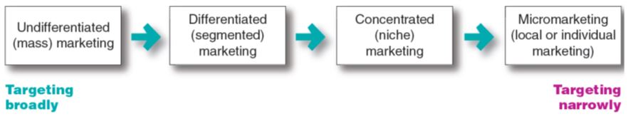
Market Targeting
Selecting Target Market Segments
Market-Targeting Strategies
Notes:
Figure 7.2 shows that companies can target very broadly (undifferentiated marketing), very narrowly (micromarketing), or somewhere in between (differentiated or concentrated marketing).
This figure covers a broad range of targeting strategies, from mass marketing (virtually no targeting) to individual marketing (customizing products and programs to individual customers). An example of individual marketing is candy lovers can buy M&M’s embossed with images of their kids or pets.

Slide 13
Market Targeting
Selecting Target Market Segments
Undifferentiated marketing targets the whole market with one offer.
Mass marketing
Focuses on common needs rather than what’s different
Can you name a company that does this?
Notes:
With undifferentiated marketing (or mass marketing), the company designs a product and a marketing program that will appeal to the largest number of buyers.
As noted in the chapter, most modern marketers have strong doubts about this strategy. Difficulties arise in developing a product or brand that will satisfy all consumers. Moreover, mass marketers often have trouble competing with more-focused firms that do a better job of satisfying the needs of specific segments and niches.

Slide 14
Market Targeting
Selecting Target Market Segments
Differentiated marketing targets several different market segments and designs separate offers for each.
Goal is to achieve higher sales and stronger position
More expensive than undifferentiated marketing
Can you name a company that does this?
Notes:
P&G markets six different laundry detergent brands in the United States, which compete with each other on supermarket shelves. Then, P&G further segments each brand to serve even narrower niches.
Developing a stronger position within several segments creates more total sales than undifferentiated marketing across all segments. Hallmark’s differentiated brands account for more than 44 percent of the greeting cards purchased in the United States. Similarly, P&G’s multiple detergent brands capture four times the market share of its nearest rival.
Differentiated marketing increases the costs of doing business. The company must weigh increased sales against increased costs when deciding on a differentiated marketing strategy.

Slide 15
Market Targeting
Selecting Target Market Segments
Concentrated marketing targets a large part of a
smaller market.
Limited company resources
Knowledge of the market
More effective and efficient
Can you name a company that does this?
Notes:
Concentrated marketing: Thanks to the reach and power of online marketing, online women’s clothing nicher ModCloth.com has attracted a devoted following. . Modcloth.com’s has a unique selection of indie clothing, engaging promotions on the ModLife blog and various social media, and Web interactivity.
When using a concentrated marketing (or niche marketing) strategy, a firm goes after a large share of one or a few smaller segments or niches. For example, Whole Foods Market thrives by catering to affluent customers that the Walmarts of the world can’t serve well.
Today, the low cost of setting up shop on the Internet makes it even more profitable to serve seemingly miniscule niches. Small businesses, in particular, are realizing riches from serving small niches on the Web.
Concentrated marketing can be highly profitable. At the same time, it involves higher-than-normal risks. Companies that rely on one or a few segments for all of their business will suffer greatly if the segment turns sour. Or larger competitors may decide to enter the same segment with greater resources. For these reasons, many companies prefer to diversify in several market segments. In fact, many large companies develop or acquire niche brands of their own.

Slide 16
Market Targeting
Selecting Target Market Segments
Micromarketing is the practice of tailoring products and marketing programs to suit the tastes of specific individuals and locations.
Local marketing
Individual marketing
Can you name a company that does this?
Notes:
Rather than seeing a customer in every individual, micromarketers see the individual in every customer. Micromarketing includes local marketing and individual marketing described on the next slides.

Slide 17
Market Targeting
Selecting Target Market Segments
Local marketing involves tailoring brands and promotion to the needs and wants of local customer segments.
Cities
Neighborhoods
Stores
Can you name a company that does this?
Notes:
Local marketing involves tailoring brands and promotions to the needs and wants of local customer groups—cities, neighborhoods, and even specific stores. For example, department store chain Macy’s has rolled out a localization program called My Macy’s in which merchandise is customized under 69 different geographical districts.
Advances in communications technology have given rise to new high-tech versions of location-based marketing. Thanks to the explosion in net-connected
smartphones with GPS capabilities and location-based social networks, companies can now track consumers’ whereabouts closely and gear their offers accordingly.
Increasingly, location-based marketing is going mobile, reaching on-the-go consumers as they come and go in key local market areas.
Discussion Question
What are the drawbacks of local marketing?
Local marketing has some drawbacks. It can drive up manufacturing and marketing costs by reducing the economies of scale. It can also create logistics problems as companies try to meet the varied requirements of different regional and local markets. Still, as companies face increasingly fragmented markets, and as new supporting technologies develop, the advantages of local marketing often outweigh the drawbacks. In addition, a brand’s overall image might be diluted if the product and message vary too much in different localities.

Slide 18
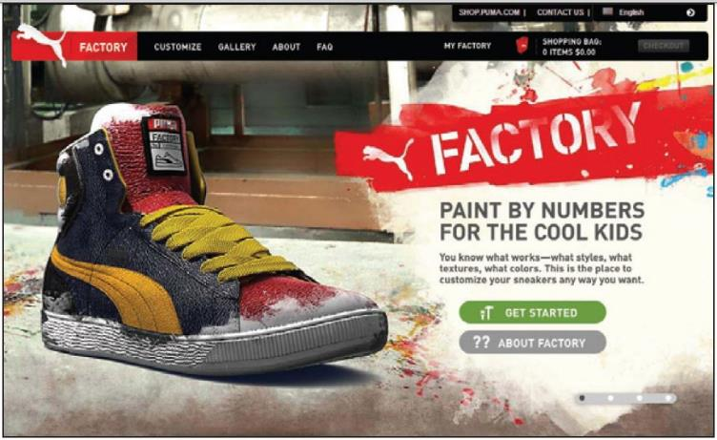
Market Targeting
Selecting Target Market Segments
Individual marketing involves tailoring products and marketing programs to the needs and preferences of individual customers.
Also known as:
One-to-one marketing
Mass customization
Notes:
Individual marketing: The PUMA Factory sneaker customization web site lets customers tailor their PUMA shoes to taste. “You know what works—what
styles, what textures, what colors. Customize your sneakers whatever way you want.”
In the extreme, micromarketing becomes individual marketing— one-to-one or markets-of-one marketing.
More detailed databases, robotic production and flexible manufacturing, and interactive media such as mobile phones and the Internet have combined to foster mass customization. Mass customization is the process by which firms interact one-to-one with masses of customers to design products and services tailor-made to individual needs. Individual marketing has made relationships with customers more important than ever.
The world appears to be coming full circle—from the good old days when customers were treated as individuals to mass marketing when nobody knew your name and then back again.

Slide 19
Market Targeting
Selecting Target Market Segments
Choosing a targeting strategy depends on
Company resources
Product variability
Product life-cycle stage
Market variability
Competitor’s marketing strategies
Notes:
As shown in the slide, companies need to consider many factors when choosing a market-targeting strategy.
When the firm’s resources are limited, concentrated marketing makes the most sense. Undifferentiated marketing is more suited for uniform products, such as grapefruit or steel.
When a firm introduces a new product, it may be practical to launch one version only, as undifferentiated marketing or concentrated marketing may make the most sense. In the mature stage of the product life cycle, however, differentiated marketing often makes more sense.
Undifferentiated marketing is appropriate where there is little market variability - most buyers have the same tastes, buy the same amounts, and react the same way to marketing efforts.
When competitors use undifferentiated marketing, a firm can gain an advantage by using differentiated or concentrated marketing, focusing on the needs of buyers in specific segments.

Slide 20
Group Work
With the co-workers in your line, discuss your:
Segmentation strategy from the first class
Which target markets from your team last week seemed the most attractive?
Which Marketing Strategy will you use for your company?
Undifferentiated?
Differentiated?
Concentrated?
Micromarketing?

Slide 21
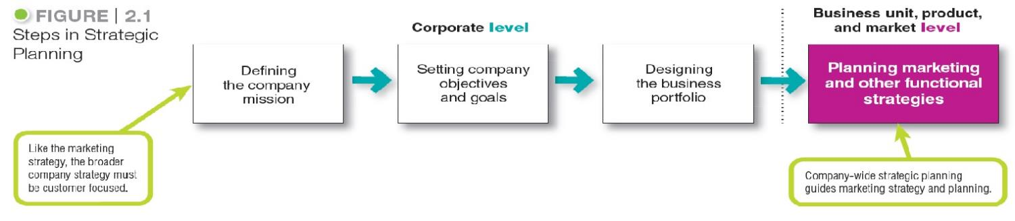
Company-Wide Strategic Planning
Steps in Strategic Planning
Notes:
At the corporate level, the company starts the strategic planning process by defining its overall purpose and mission (see Figure 2.1).
This mission is then turned into detailed supporting objectives that guide the entire company. Next, headquarters decides what portfolio of businesses and products is best for the company and how much support to give each one. In turn, each business and product develops detailed marketing and other departmental plans that support the company-wide plan.
Thus, marketing planning occurs at the business-unit, product, and market levels.
It supports company strategic planning with more detailed plans for specific marketing opportunities.

Slide 22
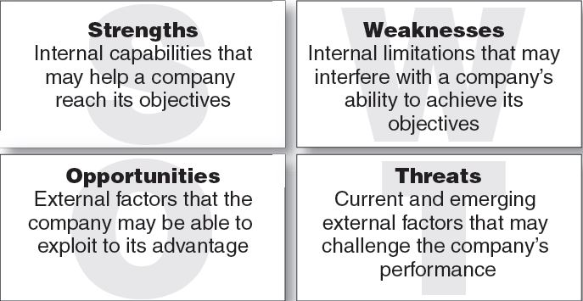
Managing the Marketing Effort
Marketing Analysis – SWOT Analysis
Internal
External
Positive
Negative
Notes:
The company should analyze its markets and marketing environment to find attractive opportunities and identify environmental threats.
It should analyze company strengths and weaknesses as well as current and possible marketing actions to determine which opportunities it can best pursue.
The goal is to match the company’s strengths to attractive opportunities in the environment, while simultaneously eliminating or overcoming the weaknesses and minimizing the threats.
Marketing analysis provides inputs to each of the other marketing management functions.

Slide 23
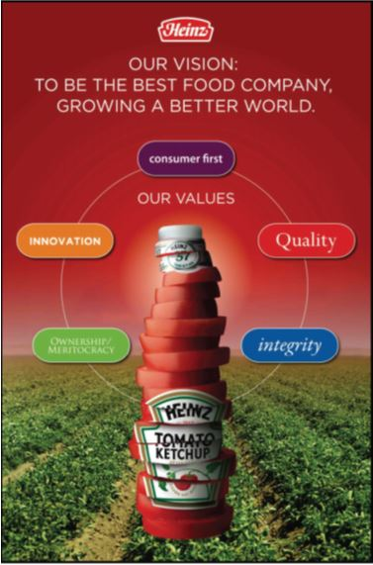
Company-Wide Strategic Planning
Setting Company Objectives and Goals
Heinz’s overall objective is to build profitable customer relationships by developing foods “superior in quality, taste, nutrition, and convenience” that embrace
its nutrition and wellness mission.
H.J. Heinz Company
Notes:
The Heinz company’s mission reflects business objectives and marketing objectives to build profitable customer relationships by developing superior products.

Slide 24
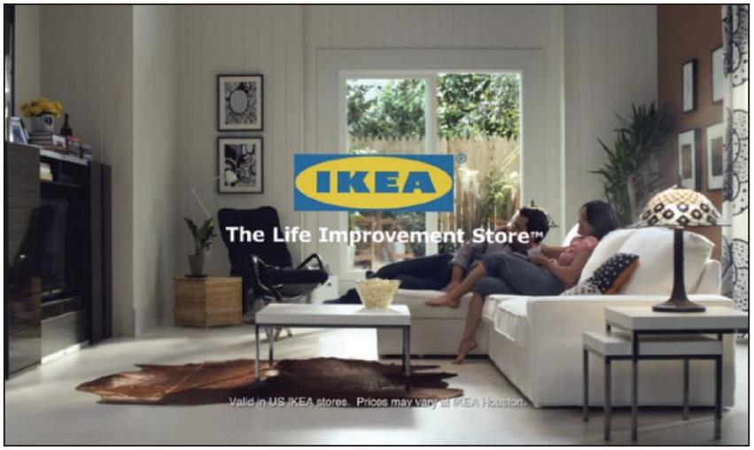
Differentiation and Positioning
Product position is the way the product is defined by consumers on important attributes.
Notes:
Positioning: IKEA does more than just sell affordable home furnishings; it’s the “Life improvement store.”
The company must decide on a value proposition—how it will create differentiated value for targeted segments and what positions it wants to occupy in those segments. The place the product occupies in consumers’ minds relative to competing products is the position. Products are made in factories, but brands happen in the minds of consumers.
Dreft is positioned as the gentle detergent for baby clothes; at IHOP, you “Come hungry. Leave happy.”; at Olive Garden, “When You’re Here, You’re Family.” In the automobile market, the Nissan Versa and Honda Fit are positioned on economy, Mercedes and Cadillac on luxury, and Porsche and BMW on performance.
To simplify the buying process, consumers organize products, services, and companies into categories and “position” them in their minds. A product’s position is the complex set of perceptions, impressions, and feelings that consumers have for the product compared with competing products.
Consumers position products with or without the help of marketers. But marketers do not want to leave their products’ positions to chance. They must plan positions that will give their products the greatest advantage in selected target markets, and they must design marketing mixes to create these planned positions.

Slide 25
Definition of Positioning (from website)
Positioning helps establish your product's or service's identity within the eyes of the purchaser. A company's positioning strategy is affected by a number of variables related to customers' motivations and requirements, as well as by its competitors' actions.
Answer these questions:
What’s the customer really buying from you?
How is your product or service different from your competitors?
What makes your product or service unique?

Slide 26
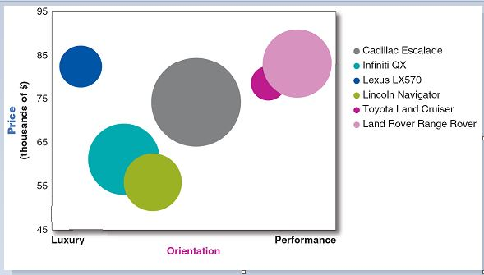
Differentiation and Positioning
Positioning Maps
Positioning maps show consumer perceptions of marketer’s brands versus competing products on important buying dimensions.
Notes:
In planning their differentiation and positioning strategies, marketers often prepare perceptual positioning maps. The position of each circle on the map indicates the brand’s perceived positioning on two dimensions: price and orientation (luxury versus performance). The size of each circle indicates the brand’s relative market share.

Slide 27
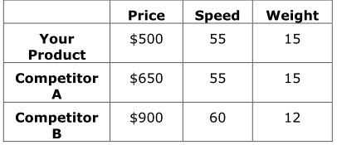
Differentiation and Positioning
Choosing a Differentiation and
Positioning Strategy
Competitive advantage is an advantage over competitors gained by offering consumers greater value, either through lower prices or by providing more benefits that justify higher prices.
Entrepreneurial Action - Caspe 3.2 – 3.3.5 → Questions on Pg. 114-115
Notes:
To build profitable relationships with target customers, marketers must understand customer needs and deliver more customer value better than competitors do. To the extent that a company can differentiate and position itself as providing superior customer value, it gains competitive advantage.
But solid positions cannot be built on empty promises. If a company positions its product as offering the best quality and service, it must actually differentiate the product so that it delivers the promised quality and service. Companies must do much more than simply shout out their positions with slogans and taglines. They must first live the slogan.

Slide 28
Differentiation and Positioning
Choosing a Differentiation and
Positioning Strategy
Identifying a set of possible competitive advantages to build a position
Choosing the right competitive advantages
Selecting an overall positioning strategy
Communicating and delivering the chosen position to the market
Notes:
Firms must differentiate their offers by building a unique bundle of benefits that appeals to a substantial group within the segment. Above all else, a brand’s positioning must serve the needs and preferences of well-defined target markets.
For example, although both Dunkin’ Donuts and Starbucks are coffee and snack shops, they target very different customers, who want very different things from their favorite coffee seller. Starbucks targets more upscale professionals with more high-brow positioning. In contrast, Dunkin’ Donuts targets the “average Joe” with a decidedly more low-brow, “everyman” kind of positioning. Yet each brand succeeds because it creates just the right value proposition for its unique mix of customers

Slide 29

Differentiation and Positioning
Choosing a Differentiation and
Positioning Strategy
Identifying a set of possible competitive advantages to
differentiate along the lines of:
Product
Services
Channels
People
Image
Copyright © 2016 Pearson Education, Inc.
7-42
Notes:
Product differentiation: Premium audio brand Bose promises “better sound through research—an innovative, high-quality listening experience.”
To find points of differentiation, marketers must think through the customer’s entire experience with the company’s product or service. An alert company can find ways to differentiate itself at every customer contact point.
Through product differentiation, brands can be differentiated on features, performance, or style and design. Thus, Bose positions its speakers on their striking design and sound characteristics. By gaining the approval of the American Heart Association as an approach to a healthy lifestyle, Subway differentiates itself as the healthy fast-food choice.
Some companies gain services differentiation through speedy, convenient, or careful delivery. For example, First Convenience Bank of Texas offers “Real Hours for Real People.” It is open seven days a week, including evenings.
Firms that practice channel differentiation gain competitive advantage through the way they design their channel’s coverage, expertise, and performance. Amazon.com and GEICO, for example, set themselves apart with their smooth-functioning direct channels.
Companies can also gain a strong competitive advantage through people differentiation—hiring and training better people than their competitors do.
Even when competing offers look the same, buyers may perceive a difference based on company or brand image differentiation. The chosen symbols, characters, and other image elements a brand chooses must be communicated through advertising that conveys the company’s or brand’s personality.

Slide 30
Differentiation and Positioning
Choosing a Differentiation and
Positioning Strategy
Choosing the Right Competitive Advantage
A difference to promote should be:
Distinctive
Superior
Communicable
Preemptive
Affordable
Profitable
Important
7-43
Notes:
Discussion Question
Are you familiar with GEICO advertisements? If so, what is their positioning?
Not all brand differences are meaningful or worthwhile, and each difference has the potential to create company costs as well as customer benefits. A difference is worth establishing to the extent that it satisfies the following criteria:
Important: The difference delivers a highly valued benefit to target buyers.
Distinctive: Competitors do not offer the difference, or the company can offer it in a more distinctive way.
Superior: The difference is superior to other ways that customers might obtain the same benefit.
Communicable: The difference is communicable and visible to buyers.
Preemptive: Competitors cannot easily copy the difference.
Affordable: Buyers can afford to pay for the difference.
Profitable: The company can introduce the difference profitably.
Many companies have introduced differentiations that failed one or more of these tests. Choosing competitive advantages on which to position a product or service can be difficult, yet such choices may be crucial to success. Choosing the right differentiators can help a brand stand out from the pack of competitors. For example, when Nokia introduced its Lumia 1020 smartphone, it didn’t position the phone only on attributes shared with competing models, such as user interface and speed. It positioned it as a smartphone with a 41 megapixel camera with a “reinvented zoom” and “full HD video” that fits today’s digital lifestyles.

Slide 31
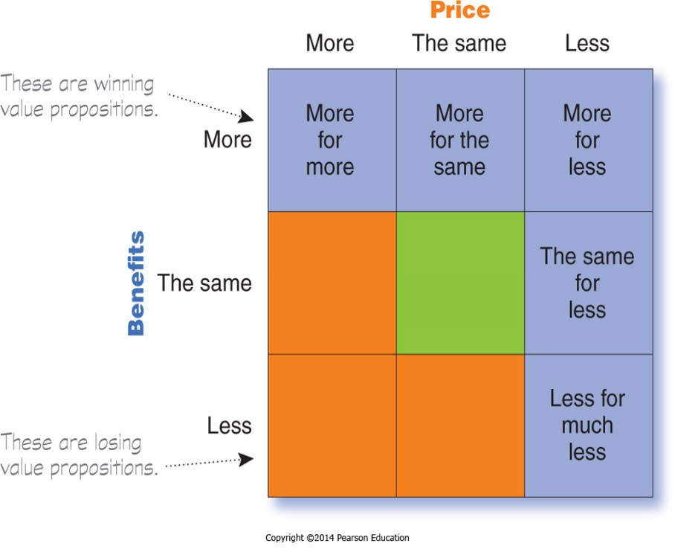
Differentiation and Positioning
Choosing a Differentiation and
Positioning Strategy
Selecting an Overall Positioning Strategy
Value proposition is the full mix of benefits upon which a brand is positioned.
Notes:
The full positioning of a brand is called the brand’s value proposition—the full mix of benefits on which a brand is differentiated and positioned. It is the answer to the customer’s question “Why should I buy your brand?” BMW’s “ultimate driving machine” value proposition hinges on performance but also includes luxury and styling, all for a price that is higher than average but seems fair for this mix of benefits.
Figure 7.4 shows possible value propositions on which a company might position its products. In the figure, the five green cells represent winning value propositions— differentiation and positioning that gives the company a competitive advantage
More for more: This positioning involves providing the most upscale product or service and charging a higher price to cover the higher costs. Although more for more can be profitable, this strategy can also be vulnerable. It often invites imitators who claim the same quality but at a lower price.
More for the same: Companies can attack a competitor’s more for more positioning by introducing a brand offering comparable quality at a lower price. For example, Toyota introduced its Lexus line with a more for the same value proposition versus Mercedes and BMW.
The same for less: Offering the same for less can be a powerful value proposition—everyone likes a good deal. Discount stores such as Walmart and “category killers” such as Best Buy, PetSmart, David’s Bridal, and DSW Shoes use this positioning.
Less for much less: A market almost always exists for products that offer less and therefore cost less. Few people need, want, or can afford “the very best” in everything they buy. In many cases, consumers will gladly settle for less than optimal performance or give up some of the bells and whistles in exchange for a lower price. For example, Family Dollar and Dollar General stores offer more affordable goods at very low prices.
More for less: Of course, the winning value proposition would be to offer more for less. Many companies claim to do this. And, in the short run, some companies can actually achieve such lofty positions. For example, when it first opened for business, Home Depot had arguably the best product selection, the best service, and the lowest prices compared to local hardware stores and other home improvement chains. Offering more usually costs more, making it difficult to deliver on the “for less” promise in the long run.
All said, each brand must adopt a positioning strategy designed to serve the needs and wants of its target markets. More for more will draw one target market, less for much less will draw another, and so on. Thus, in any market, there is usually room for many different companies, each successfully occupying different positions. The important thing is that each company must develop its own winning positioning strategy, one that makes the company special to its target consumers.

Slide 32
Differentiation and Positioning
Choosing a Differentiation and
Positioning Strategy
Positioning statement summarizes company or brand positioning using this form: To (target segment and need) our (brand) is (concept) that (point of difference)
Notes:
The company and brand positioning should be summed up in a positioning statement. An example using the above form is shown on the next slide.
The case for the brand’s superiority is made on its points of difference. For example, the U.S. Postal Service ships packages just like UPS and FedEx, but it differentiates its priority mail from competitors with convenient, low-price, flat-rate shipping boxes and envelopes. “If it fits, it ships,” promises USPS.

Slide 33

Differentiation and Positioning
Choosing a Differentiation and
Positioning Strategy
Positioning Statement Example for Evernote:
“To busy multitaskers who need help remembering things, Evernote is a digital content management application that makes it easy to capture and remember moments and ideas from your everyday life using your computer, phone, tablet, and the Web.”
Notes:
Here is a positioning statement example using the popular digital information management application, Evernote: “To busy multitaskers who need help remembering things, Evernote is a digital content management application that makes it easy to capture and remember moments and ideas from your everyday life using your computer, phone, tablet, and the Web.”
Note that the positioning statement first states the product’s membership in a category (digital content management application) and then shows its point of difference from other members of the category (easily capture moments and ideas and remember them later). Evernote helps you “remember everything” by letting you take notes, capture photos, create to-do lists, and record voice reminders, and then makes them easy to find and access using any device, anywhere—at home, at work, or on the go.

Slide 34
Communicating and Delivering the Chosen Position
Differentiation and Positioning
Choosing the positioning is often easier than implementing the position.
Example: McDonald’s having the same tasting burger everywhere
Establishing a position or changing one usually takes a long time.
Maintaining the position requires consistent performance and communication.
Notes:
Once it has chosen a position, the company must take strong steps to deliver and communicate the desired position to its target consumers. All the company’s marketing mix efforts must support the positioning strategy. Positioning the company calls for concrete action, not just talk. If the company decides to build a position on better quality and service, it must first deliver that position.
Companies must closely monitor and adapt the position over time to match changes in consumer needs and competitors’ strategies. However, the company should avoid abrupt changes that might confuse consumers, and should evolve gradually as it adapts to the ever-changing marketing environment.

Slide 35
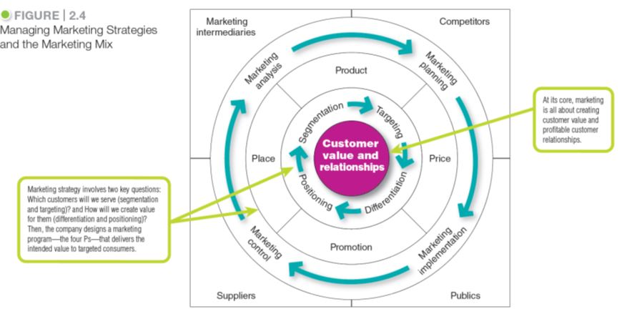
Marketing Strategy and the Marketing Mix
2-35
Notes:
Consumers stand in the center of Figure 2.4 where the goal is to create value for customers and build profitable customer relationships.
Next comes marketing strategy—the marketing logic by which the company hopes to create this customer value and achieve these profitable relationships. The company decides which customers it will serve (segmentation and targeting) and how (differentiation and positioning).
Guided by marketing strategy, the company designs an integrated marketing mix made up of factors under its control—product, price, place, and promotion (the four Ps).
To find the best marketing strategy and mix, the company engages in marketing analysis, planning, implementation, and control.
Through these activities, the company watches and adapts to the actors and forces in the marketing environment.

Slide 36
Marketing Strategy and the Marketing Mix
Customer Value-Driven
Marketing Strategy
Marketing strategy is the marketing logic by which the company hopes to create customer value and achieve profitable customer relationships.

Slide 37

Marketing Strategy and the Marketing Mix
Customer Value-Driven Marketing Strategy
Positioning: The 100-year-old Del Monte brand positions itself as “Bursting with Life: Made in America. Picked and packed at the peak of ripeness.
Same essential ingredients as fresh.”
- Del Monte Corporation
Notes:
The iconic 100-year-old Del Monte brand designed its entire integrated marketing campaign—from television and print ads to its online, mobile, and social media content—around the “Bursting with Life” positioning.
More than just words, the campaign slogan positions Del Monte’s canned fruits and vegetables as quality ingredients that contribute to a healthy lifestyle. They are “grown in America, picked and packed at the peak of ripeness, [and contain the] same essential nutrients as fresh.”

Slide 38
Groups
Create a Positioning Statement for your organization using the framework: To (target segment and need) our (brand) is (concept) that (point of difference)
Describe your Market Strategy thus far, in terms of:
Market Segmentation - a group of consumers who respond in a similar way to a given set of marketing efforts.
Market Targeting - the process of evaluating each market segment’s attractiveness and selecting one or more segments to enter
Market Positioning - the arranging for a product to occupy a clear, distinctive, and desirable place relative to competing products in the minds of target consumers

